Slide 1
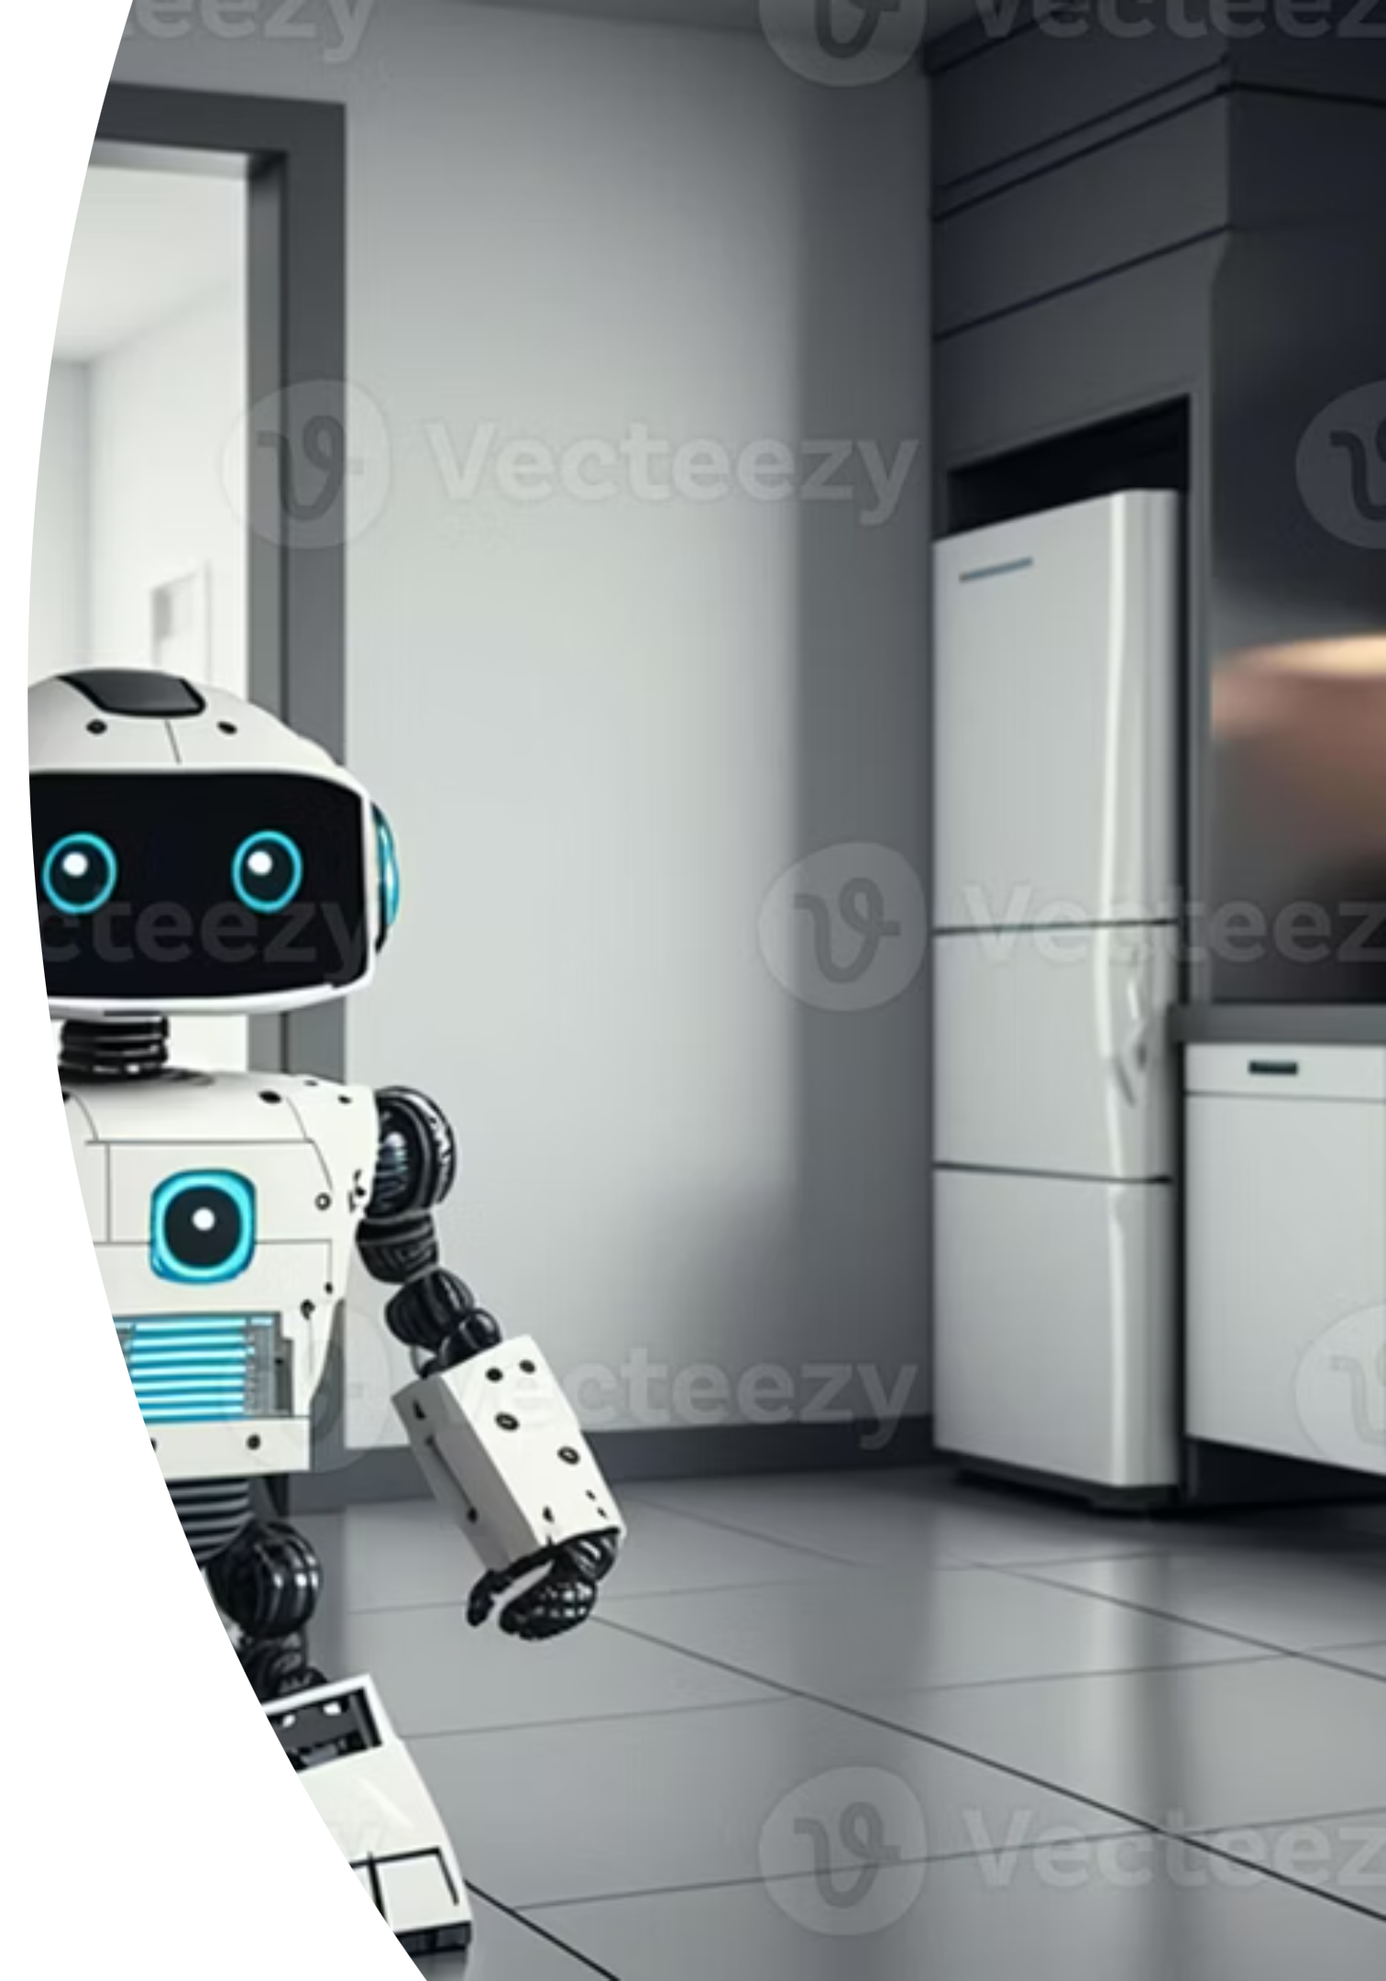
Event : DataQuest Hackathon
CompanionAI: Your Smart Home Assistant
AI-Powered Appliance Troubleshooting & Safety
Fixing appliances has never been smarter or safer.
Team name: SupportLess

Slide 2



The Problem we're Solving
🏠 Home Appliance Crisis
Current Pain Points:
47 million households face appliance issues annually
Confusing error codes
Average repair cost: $150-400 per incident
Safety risks: 15,000+ appliance-related emergencies yearly
Knowledge gap: Complex manuals, technical jargon
Expensive service calls
Time waste: Hours waiting for technician availability
Safety hazards from DIY attempts
Long repair wait times

Slide 3





Key Features & Benefits
Instant Diagnosis
Step-by-Step Guidance
Safety Alerts
Get immediate, accurate identification of appliance issues, saving time and frustration.
Follow clear, easy-to-understand instructions for DIY fixes, even for complex problems.
Receive critical warnings about potential hazards, protecting your home and family.
Cost Savings
24/7 Availability
Avoid expensive technician call-out fees with effective self-repair solutions.
Access support anytime, anywhere, ensuring help is always at your fingertips.

Slide 4
Our Solution - CompanionAI
🤖 AI-Powered Appliance Assistant
Real-time troubleshooting with a safety-first approach.
🔧 Instant Diagnosis
🛡 Safety First
📱 User-Friendly
Error code interpretation
Emergency detection & prevention
Natural language interface
📚 Expert Knowledge
⚡ Fast Response
652 manual chunks database
<2 second average response time

Slide 5
What is RAG? (Retrieval-Augmented Generation)
🧠 The Brain Behind CompanionAI
RAG = Retrieval + AI Generation
How it Works:
Why RAG?
User Query
Accurate
"My Samsung shows E3 error"
Uses actual manual content
Vector Search
Updated
Find relevant manual sections
Real manufacturer information
Context Building
Contextual
Combine manual + query
Understands specific models
AI Generation
Reliable
Create personalized solution
Grounded in verified sources
Safety Check
Validate response safety

Slide 6
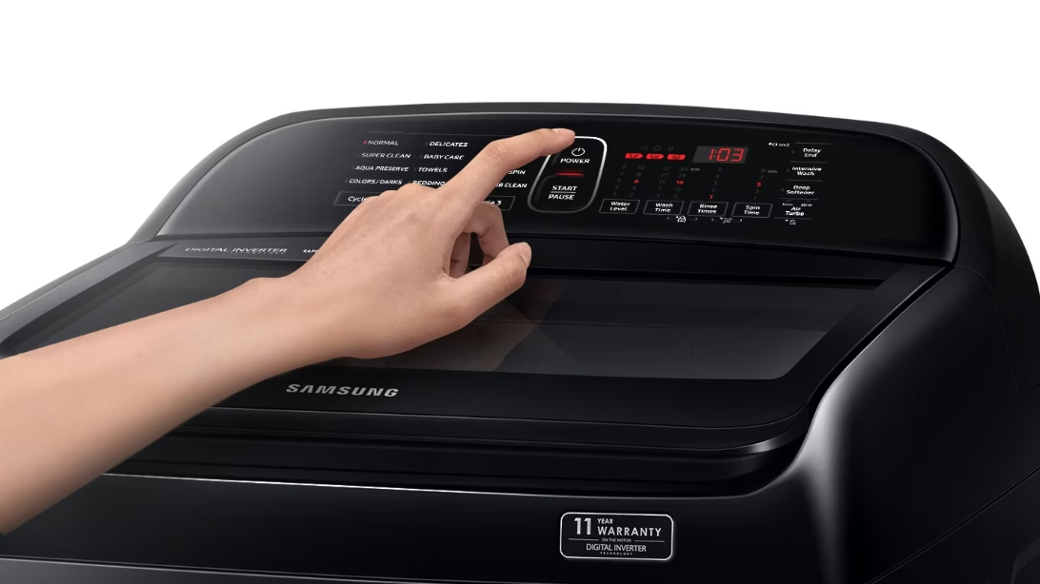

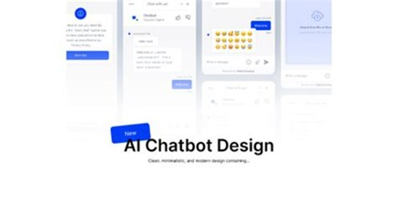
Demo & User Experience
The Challenge
Seamless Interaction
Intelligent Solution
Users often face cryptic error codes or complex issues with their home appliances, leading to frustration and lengthy manual searches. CompanionAI simplifies this process.
CompanionAI provides immediate, step-by-step solutions derived from verified manuals, ensuring accuracy and saving valuable time and effort.
Our intuitive chat interface allows users to quickly articulate their problem, just like talking to an expert technician. No jargon, just natural language.

Slide 7
Database Architecture
🗄 Vector Database Structure
FAISS Vector Database:
652 manual chunks from 5 appliance categories
384-dimensional embeddings using sentence-transformers
Sub-second search with cosine similarity
Metadata tracking for source attribution
Brands & Coverage:
Brand
Chunks
Models
Samsung
156
WF45, RF23J9011, etc.
LG
142
MS2595, WM3488HW, etc.
Whirlpool
127
WOS51EC0HS, WFW92HEFW
Bosch
98
BGL72294, WAT28401UC
Philips
89
HR7761, HD9641/96

Slide 8

Safety-First Architecture
🛡 4-Level Safety Classification
🟢 SAFE
Normal troubleshooting
e.g., Filter clean, Reset device
🟡 CAUTION
Minor warnings
e.g., Water near electrical, Hot surfaces
🟠 DANGER
Strong alerts
e.g., Electrical sparks, Smoke smell
🔴 EMERGENCY
Immediate evacuation
e.g., Gas leaks, Fire risk
Emergency Override System:
98% accuracy in safety detection
Instant override bypasses normal processing
Emergency templates for immediate response
Escalation protocols for critical situations

Slide 9
1. 🎤 Voice-to-Voice Assistant
Add speech-to-text (STT) using Whisper or Google Speech API for user queries.
Use text-to-speech (TTS) with models like gTTS, ElevenLabs, or Coqui TTS for natural replies.
This makes the chatbot hands-free, perfect for technicians working while repairing machines.
2. 🔧 Intelligent Detachment & Reassembly Guidance
Extend preprocessing to tag steps as:
Disassembly (detaching parts)
Reassembly (fixing back parts)
Testing / Validation
Modify retrieval to always suggest complete workflows (detach → repair → reattach → test).
Users won’t miss critical steps when putting the appliance back together.
3. 🧠 Personalized Repair Assistant
Track appliances owned by a user.
Maintain a history of previous repairs/issues.
Offer predictive maintenance suggestions:
“It’s been 6 months since last cleaning the lint trap, you should do it again.”
4.📲 QR Code–Based Manual Retrieval Scan the appliance’s QR code with a phone. Automatically detect brand/model. Fetch the correct manual from the database. Instantly answer user queries without manual uploads.
Future Work

